Slide 1

Unit - 6
Introduction to engineering materials

Slide 2
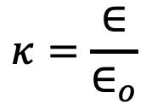
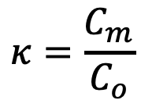
Dielectric
Dielectric is an insulator (as they do not have any loosely bound or free electrons) when subjected to external electric field get polarized.
Dielectric constant, also called relative permittivity is define as the ratio of the capacitance of a capacitor with dielectric to the capacitance of an identical capacitor in a vacuum without the dielectric material.
OR
Define as the ratio of permittivity of material to the permittivity of free space.
$$κ=\frac{C_{m}}{C_{o}}$$
OR
$$κ=\frac{∈}{∈_{o}}$$

Slide 3
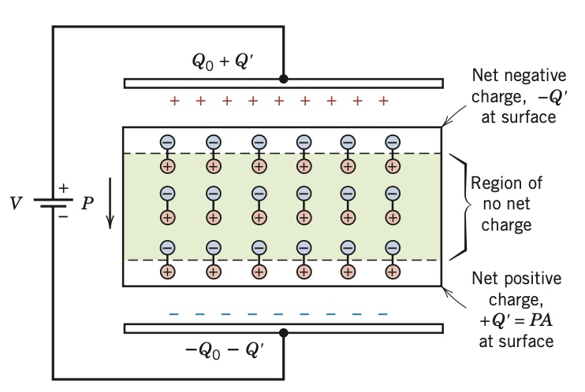

Slide 4
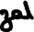
Polarizability
Polarizability of an atom / molecule is define as ratio of induced dipole moment to applied electric field.

Slide 5
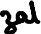
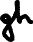
Permittivity
Property of every medium which measure the opposition offered against the formation of an electric field.
Electric Susceptibility: How easily a material can be polarized in response to applied electric field.

Slide 7
Types of dielectric
Dielectric
Polar dielectric
Non - polar dielectric

Slide 8
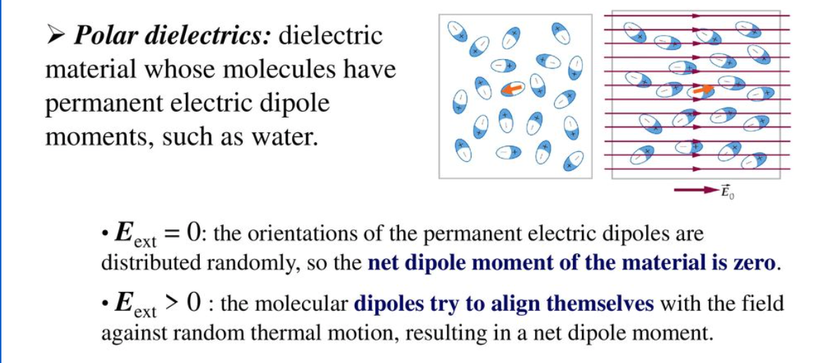
Polar dielectric

Slide 9
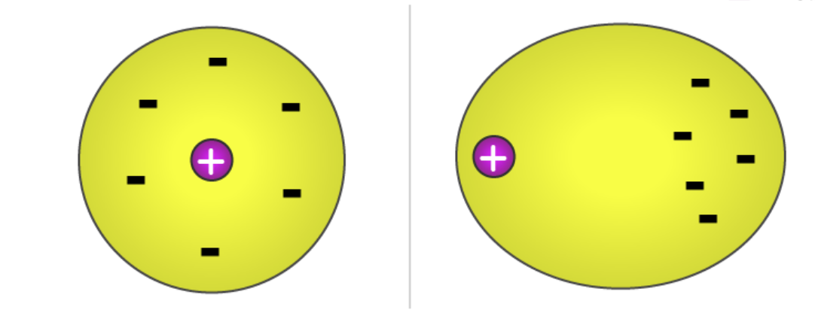
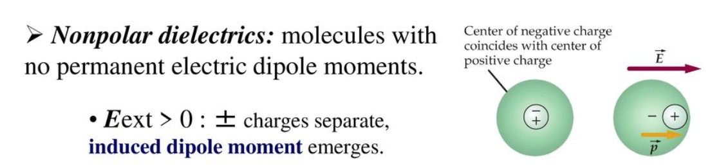
Nonpolar dielectric
E = 0
E > 0

Slide 10
Magnetic material

Slide 11
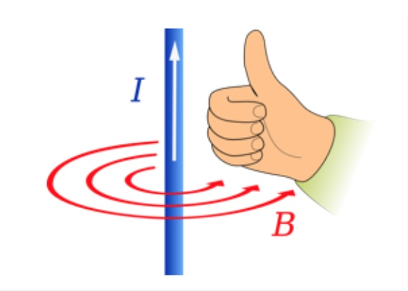
Magnetic field
Created by current through a wire.
moving charges produce magnetic fields which are proportional to the current, and hence a current carrying conductor produces a magnetic affect around it.

Slide 12
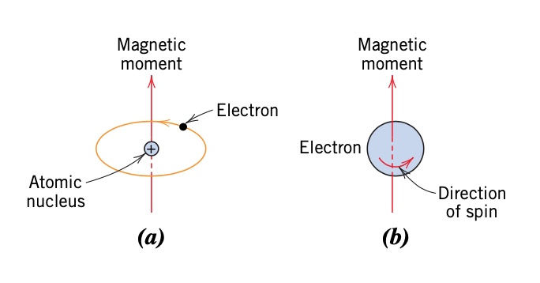
Origin of magnetism
Spin of electrons
Orbital motion of electrons
Nucleus spin (contribution is very small)

Slide 13
Parameters (in magnetism)
Magnetic Moment (m or μ ): Measure of the strength of the magnet. Unit – Am² . For current loop m = IA
Magnetic field strength/Magnetizing field (H): Measure of the strength of the externally applied field. Unit - A/m.
Magnetization (M): magnetic moment (m) per unit volume (V). Unit - A/m. When magnetic material is placed in an external magnetic field, it acquires magnetic moment. M measures the materials response to the applied field H.
Magnetic induction/Magnetic flux density (B): Magnetic flux per unit area. Measure no of field lines inside the material per unit area. Units- Tesla or Weber/m².

Slide 14
Magnetic susceptibility (χ_{m}): measure how easily material can be magnetized in presence of external magnetic field. Unitless.
permeability unit-
weber per ampere-meter (Wb/A∙m) or henrie per meter (H/m)

Slide 15
Diamagnetic material
In diamagnetic materials all the electrons are paired so there is no permanent net magnetic moment per atom. e.g. antimony, silver, and gold
diamagnetic materials are repelled by a magnetic field. Get magnetized feebly in the direction opposite to applied magnetic field.
do not retain the magnetic properties when the external field is removed.
magnetic relative permeability is less than one.
have a small, negative magnetic susceptibility (~ - 10⁻⁵).
dipole moment of the diamagnetic substances is lower and in the opposite direction of the magnetic field H.

Slide 16
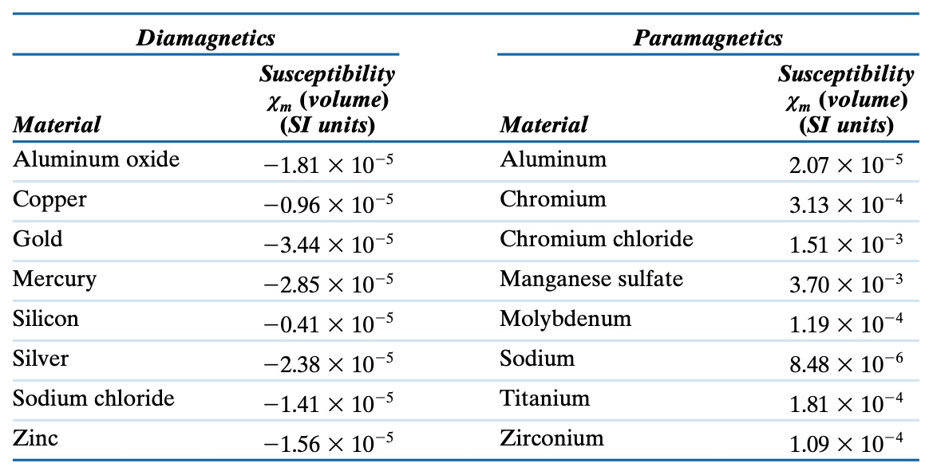
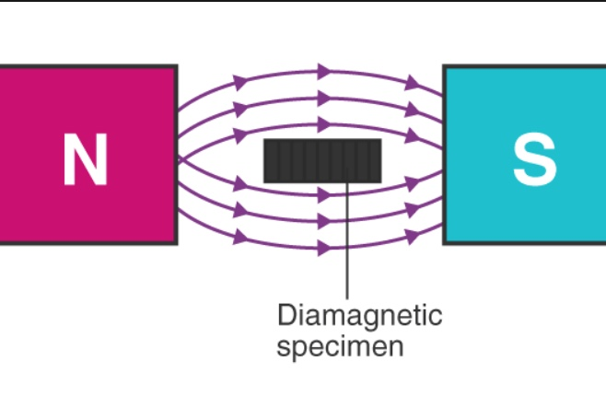
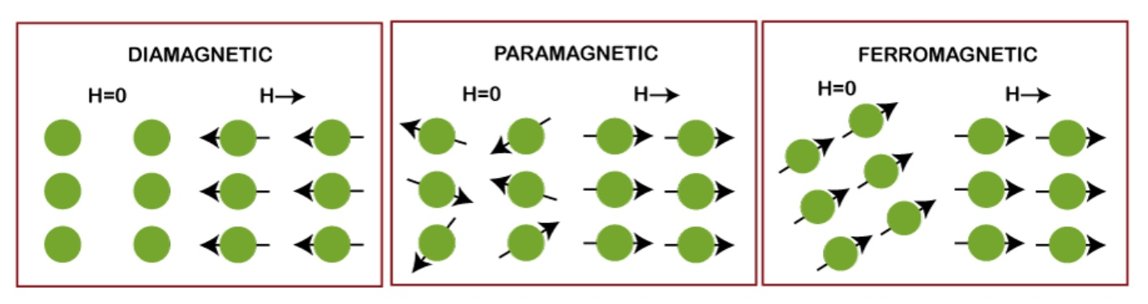
In non-uniform magnetic filed these substances attracted towards the region where field is weak.
No effect of temperature.

Slide 17
Paramagnetic material
Paramagnetic properties are due to the presence of some unpaired electrons, so there is permanent net magnetic moment but randomly orientated. In presence of external magnetic filed magnetic diploes align with the field. e.g. magnesium, molybdenum, lithium, aluminium etc..
Paramagnetic materials are feebly attracted by a magnetic field.
do not retain the magnetic properties when the external field is removed.
The magnetic permeability is more than unity.
have a small, positive magnetic susceptibility (10⁻⁵ to 10⁻²).
In non-uniform magnetic filed these substances move from weaker field to stronger field.
Magnetic susceptibility is inversely proportional to temperature.

Slide 18
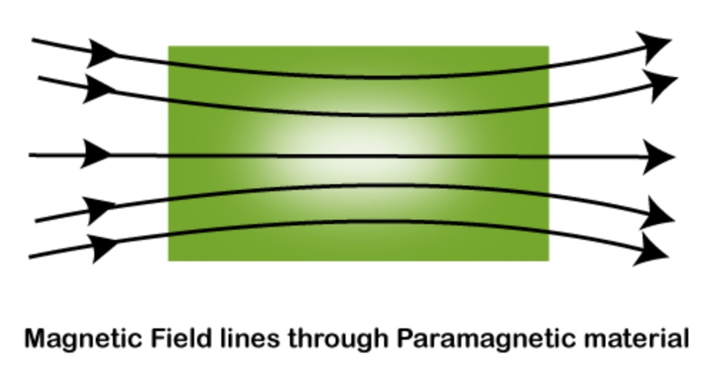

Slide 19
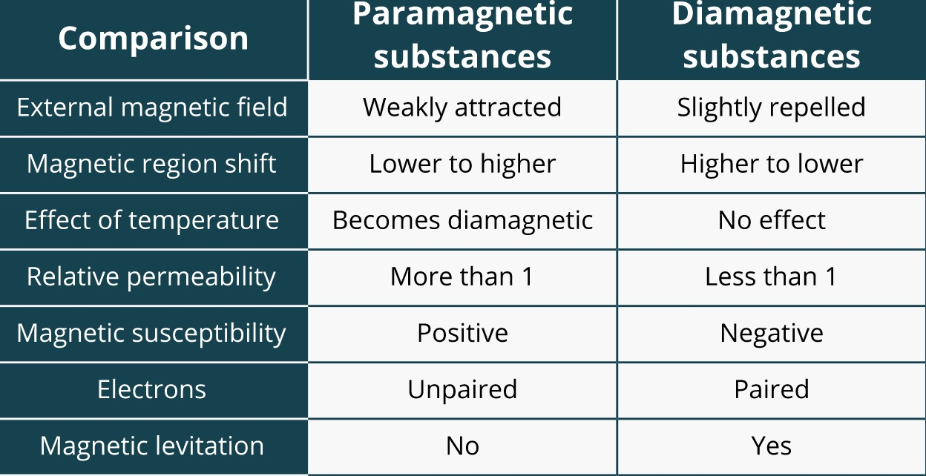

Slide 20
Ferromagnetic material
Ferromagnetic properties are due to the presence of some unpaired electrons, so there is permanent net magnetic moment. They get their strong magnetic properties due to the presence of magnetic domains. In these domains, large numbers of atom's moments (10¹² to 10¹⁵) are aligned parallel (coupling interactions cause net spin magnetic moments of adjacent atoms to align with one another, even in the absence of an external field) so that the magnetic force within the domain is strong. e.g. iron, cobalt, nickel etc..
Ferromagnetic materials are strongly attracted by a magnetic field.
Retain the magnetic properties when the external field is removed.
The magnetic permeability is greater than unity.
have a large, positive magnetic susceptibility (~ 10⁶).
In non-uniform magnetic filed these substances move from weaker parts of field to stronger parts of field.

Slide 21
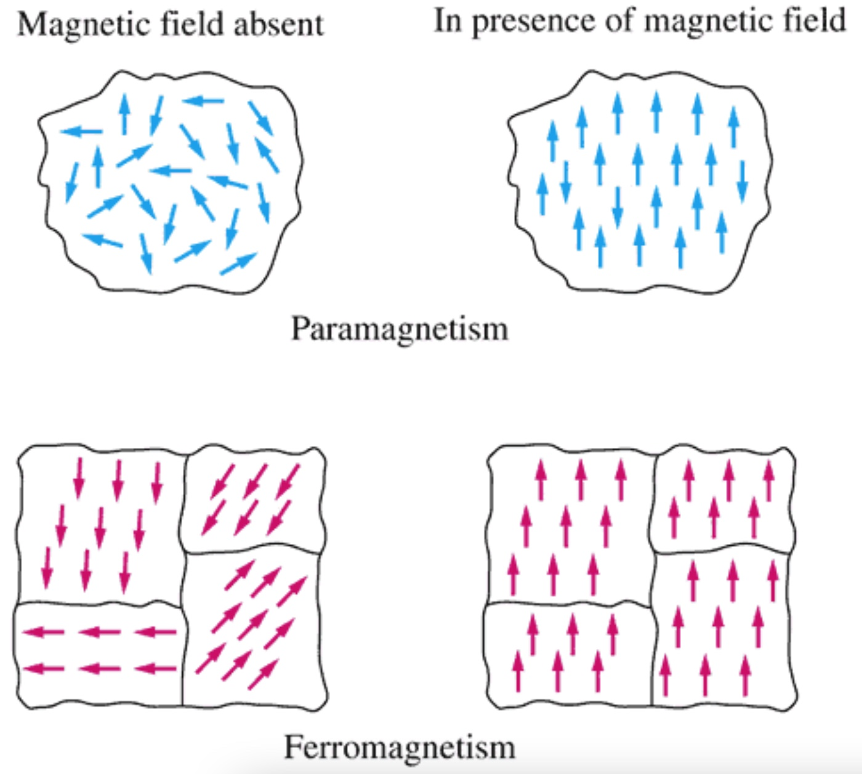

Domain

Slide 23
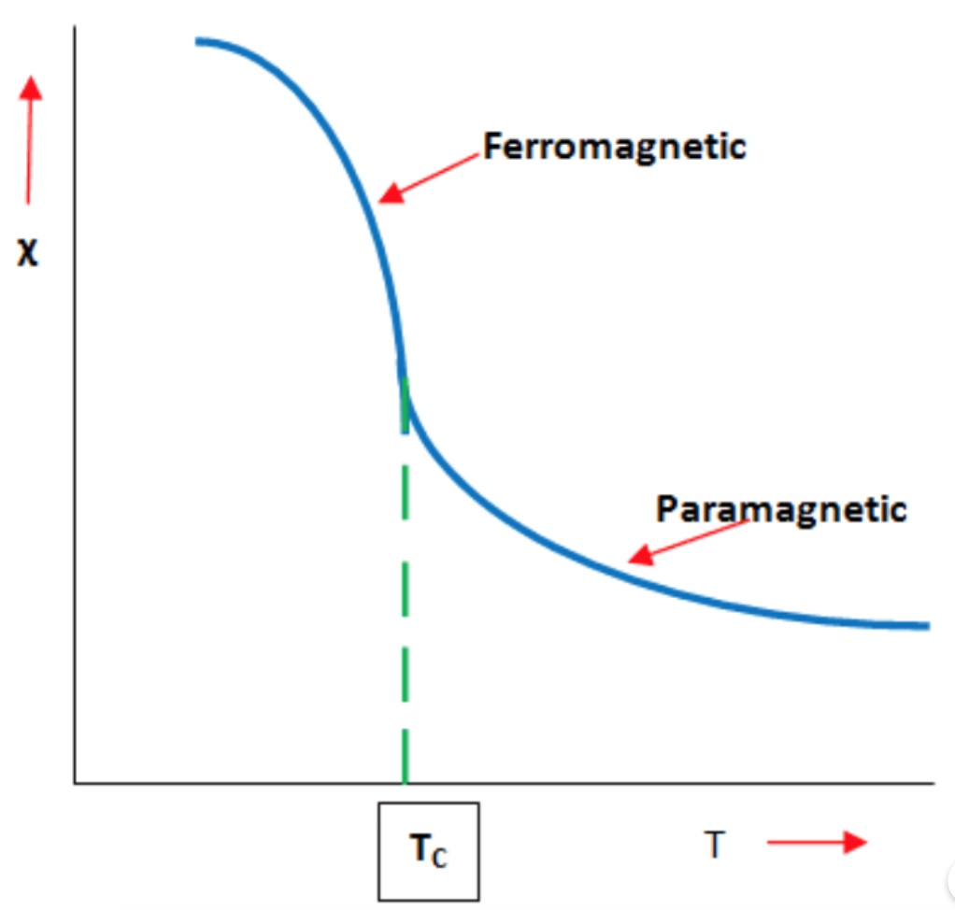
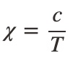
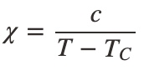
Temperature dependence of magnetic property
Curie Temperature, temperature at which certain magnetic materials undergo a sharp change in their magnetic properties.
At low temperatures, magnetic dipoles are aligned. Above the curie point, random thermal motions nudge dipoles out of alignment.
Paramagnets
C is material-specific Curie constant,
T_{c} is curie temperature
Ferromagnets

Slide 24
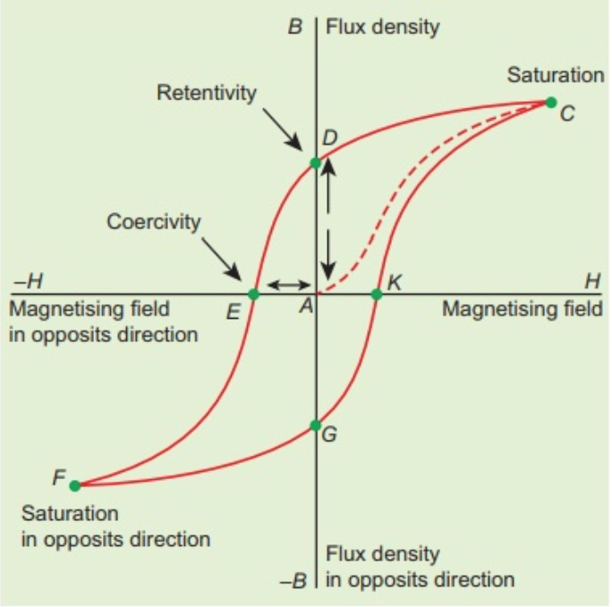
Hard and soft magnetic materials
Hysteresis loop of the ferromagnetic materials vary in size and shape. This variation in hysteresis loops leads to a broad classification of all the magnetic materials into hard type and soft type.
Hard magnets | Soft magnets
Cannot be easily magnetized | Can be easily magnetized
Hysteresis loop area is large Susceptibility and Permeability values are small. | Hysteresis loop area is small Susceptibility and Permeability values are high.
Retentivity and Coercivity are large | Retentivity and Coercivity are small
Uses: Permanent magnets, DC magnets. | Uses: Electro magnets, computer data storage. Transformer core
Alnico, Chromium steel, tungsten steel, carbon steel. | Iron-silicon alloy, Ferrous nickel alloy, Ferrites Garnets

Slide 25
Magnetic data storage
Magnetic storage is one of the most widely used digital data storage using a magnetized medium.
Several types of magnetized medium are used to store data such as magnetic tape, floppy disks and hard disk drives.
The basic approach to magnetic data storage is almost similar for the different types of media.

Slide 26
The medium used in magnetic storage devices is coated with ferromagnetic material like iron oxide.
The storage media contains magnetic surface and it is divided into very very small regions of mostly uniform magnetization.
There are two types of magnetic polarities i.e. N-S and S-N each one is used to represent either 0 or 1.
Computer system needs to store data in digital forms consists of binary information i.e. data in the forms of 0 or 1.

Slide 27
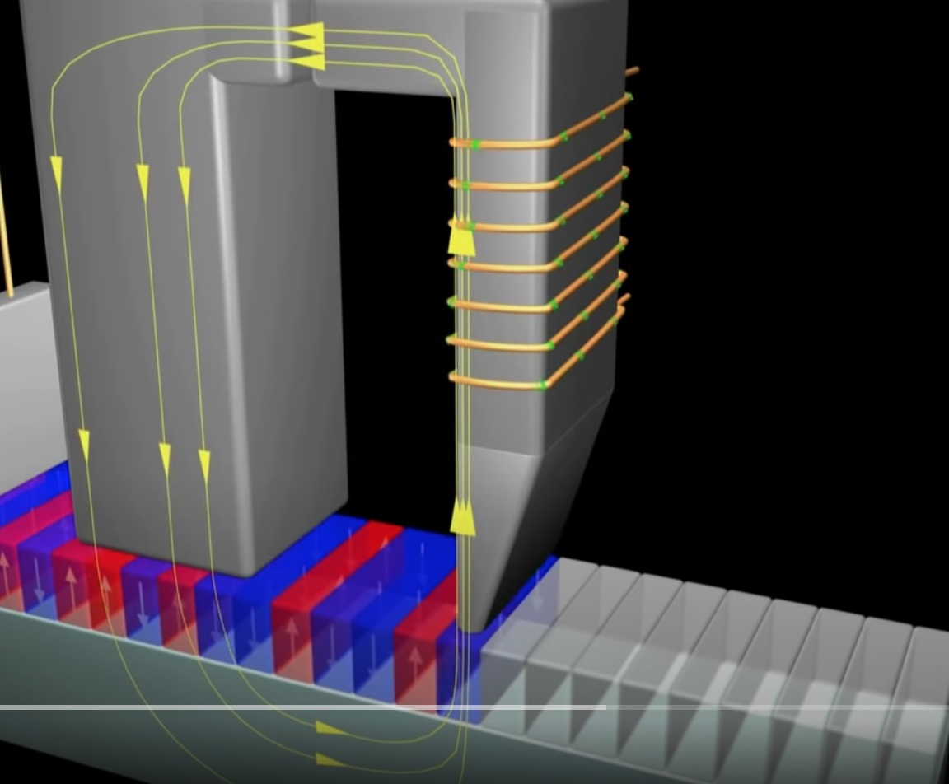
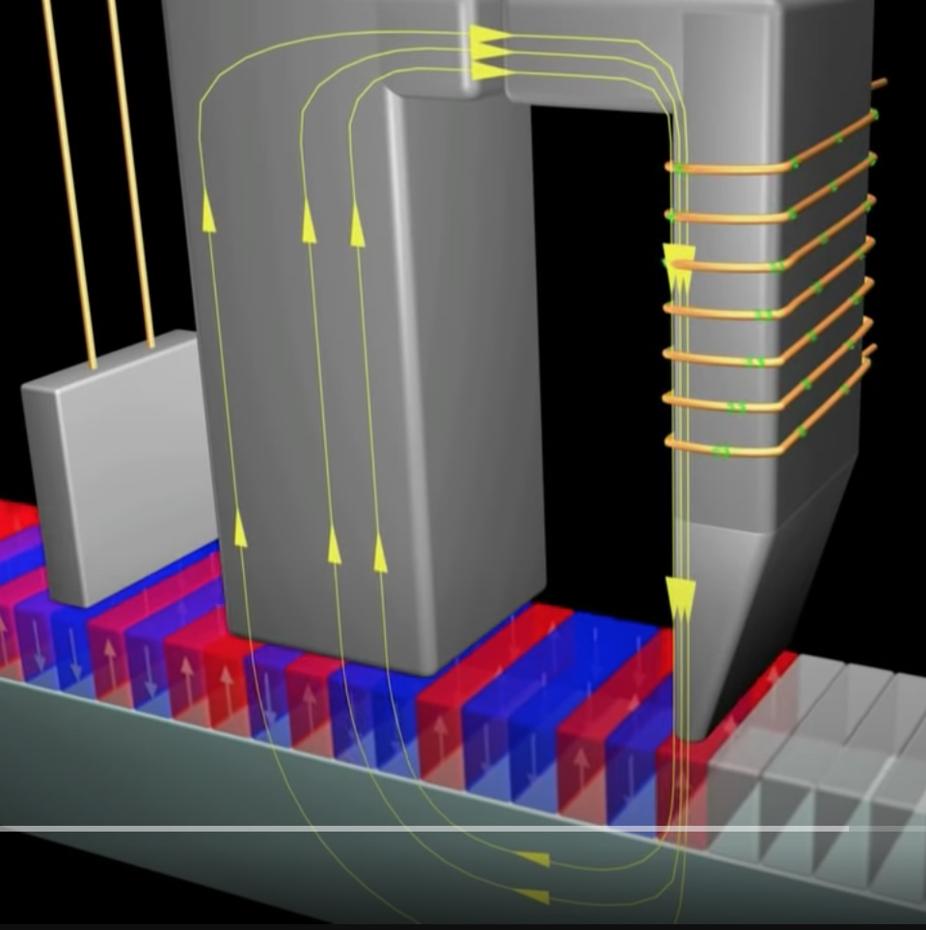
The drive uses a motor to rotate the media at a high speed (5400 or 7200 rpm). The data is written and read using a small device called head. Each head has a tiny electro-magnetic sensor which consists of an iron core wrapped with wire. This head operates very close to the magnetized material.
1
1
0
1
The data signal is sent through the coil of wire which generates a magnetic flux. At the gap (a few nano-meters), This flux magnetizes small regions of the oxide on the media.
The information is stored on the disk in the forms of 0s and 1s on magnetized regions respectively.

Slide 28
Piezoelectric material

Slide 29
Piezoelectric materials
Piezoelectric materials are materials that have the ability to generate internal electrical charge from applied mechanical stress.​ The term ​piezo​ is Greek for "squeeze or press.” e.g. bone, proteins, quartz crystal and lead zirconate titanate (ceramics) etc..

Slide 30
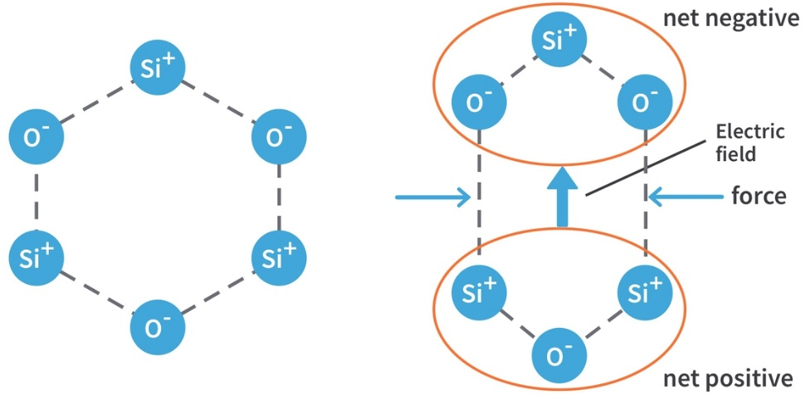
Piezoelectric effect is formed in crystal having no center of symmetry.
Each molecule has polarization (under stress), one end is more negatively charged and other end is positively charged, and that formed dipole. This is a result of the atoms that makeup the molecule and the way the molecules shaped.

Slide 31
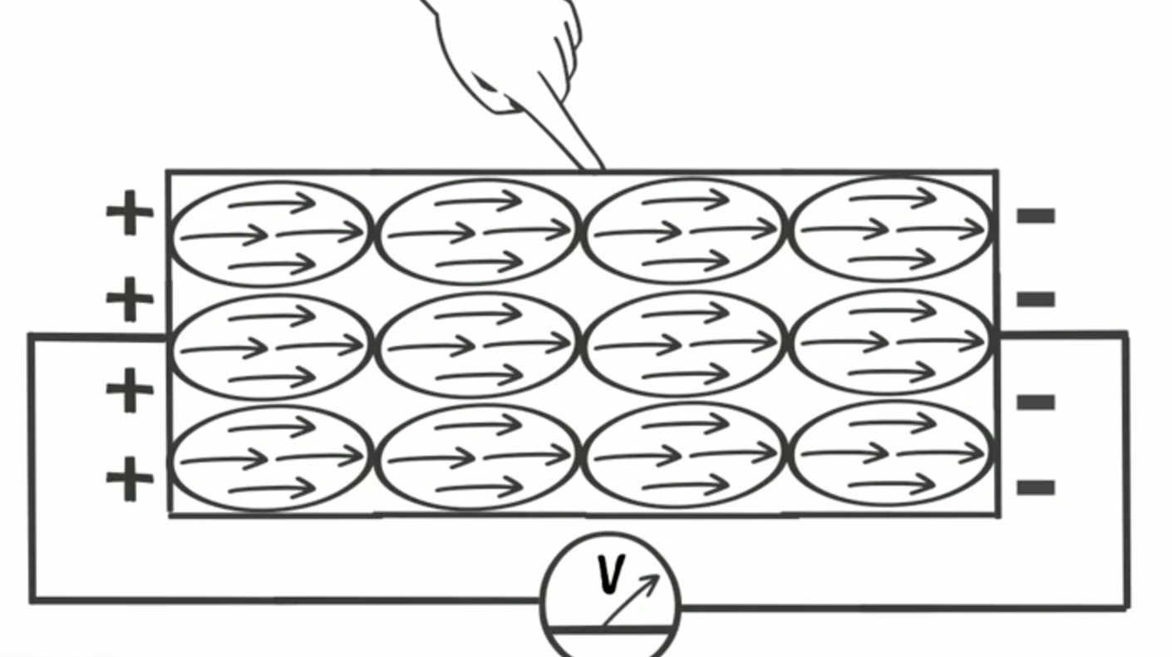
Direct piezoelectric effect
Piezoelectricity (also called the piezoelectric effect) is the appearance of an electrical potential (a voltage, in other words) across the sides of a crystal when subject it to mechanical stress (by squeezing it).
gas burners
piezoelectric microphones
detection of ultrasound wave (e.g. medical, SONAR)

Slide 32
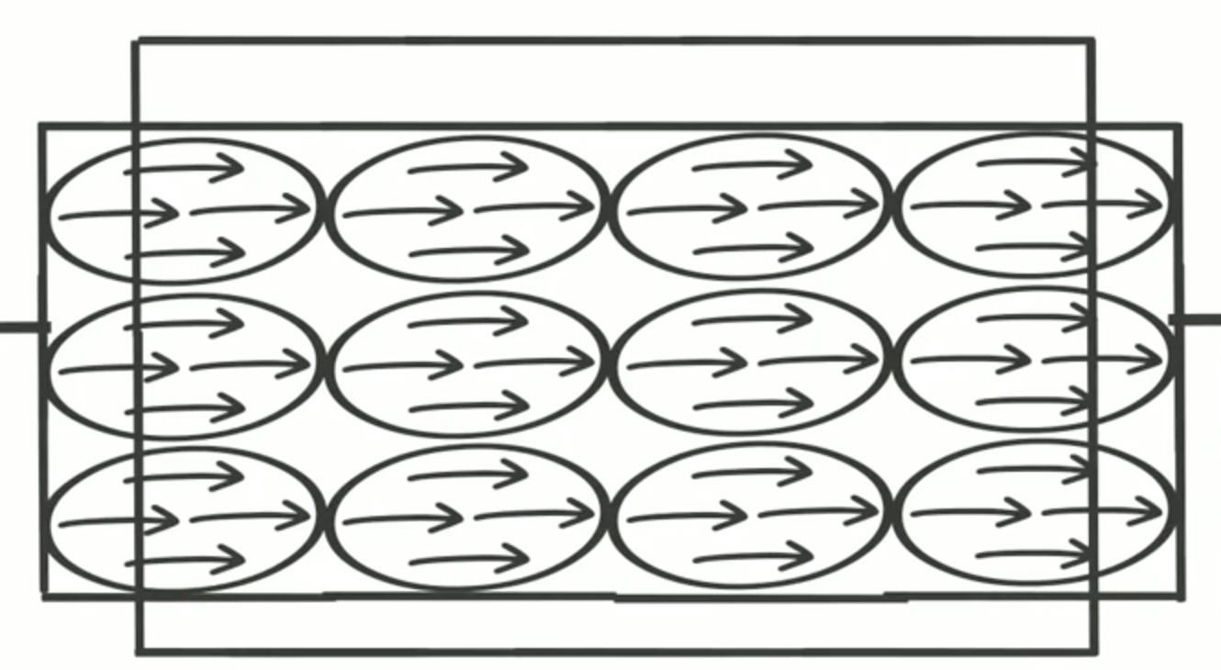
Inverse / converse piezoelectric effect
Alternative field produce the strain (vibrate back and forth) in the crystal.
used in production of ultrasound (frequency greater than 20K Hz) in medical (ultrasound) and SONAR.

Slide 33
Ultrasonic sensor
Ultrasound transducers are used in routine medical imaging. A ​transducer​ is a piezoelectric device that acts as both a sensor and an actuator. ​Ultrasound transducers​ contain a piezoelectric element that converts an electrical signal into mechanical vibration (transmit mode or actuator component) and mechanical vibration into electric signal (receive mode or sensor component).

Slide 34
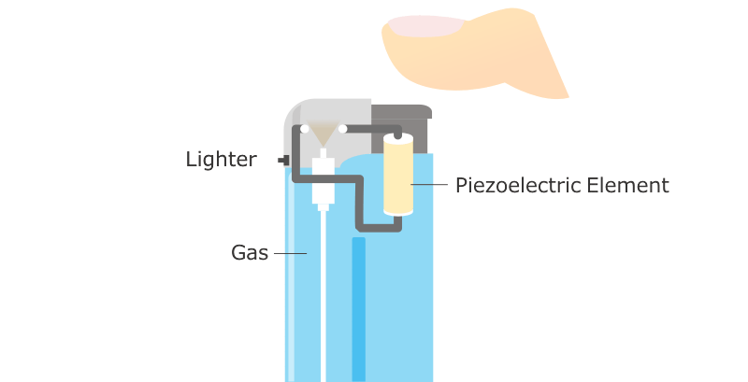

Slide 35
Superconductors

Slide 36
Superconductivity
Certain metals and alloys exhibit almost zero resistivity (i.e. infinite conductivity) when they are cooled to certain temperature. This phenomenon is called superconductivity, and material are known as superconductors. This phenomenon was first observed by H.K. Onnes in 1911. He found that when pure mercury was cooled down to 4.12K, the resistivity suddenly dropped to zero.
The temperature at which the transition from normal state to superconducting state takes place on cooling in the absence of magnetic field is called the critical temperature (T_{c} ) or the transition temperature. The transition temperature depends on the property of the material. It is found that the superconducting transition is reversible, i.e, above critical temperature (T_{c}) a super conductor becomes a normal conductor.

Slide 37
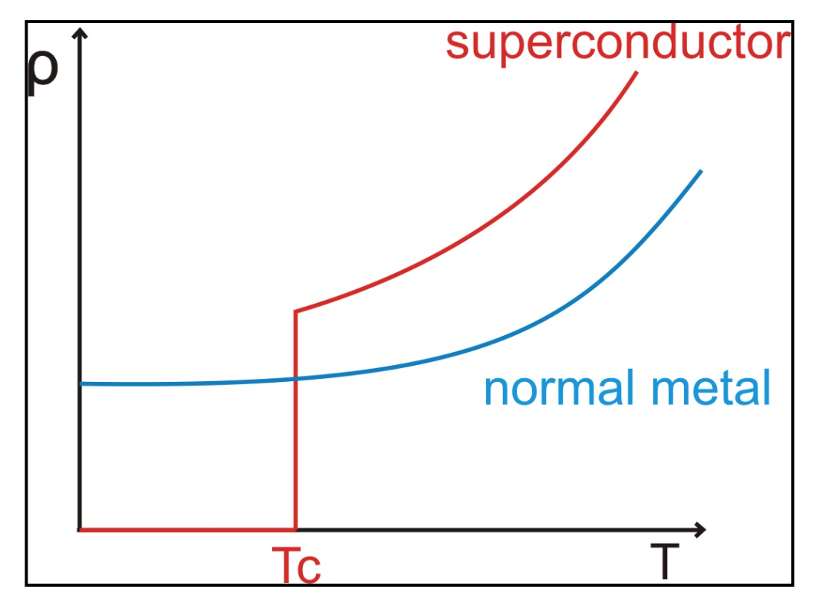
Resistivity vs Temperature

Slide 38
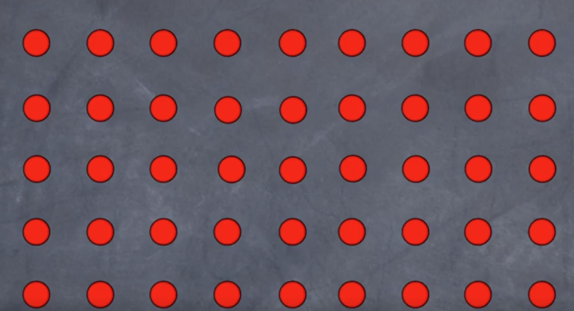
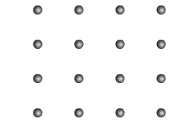
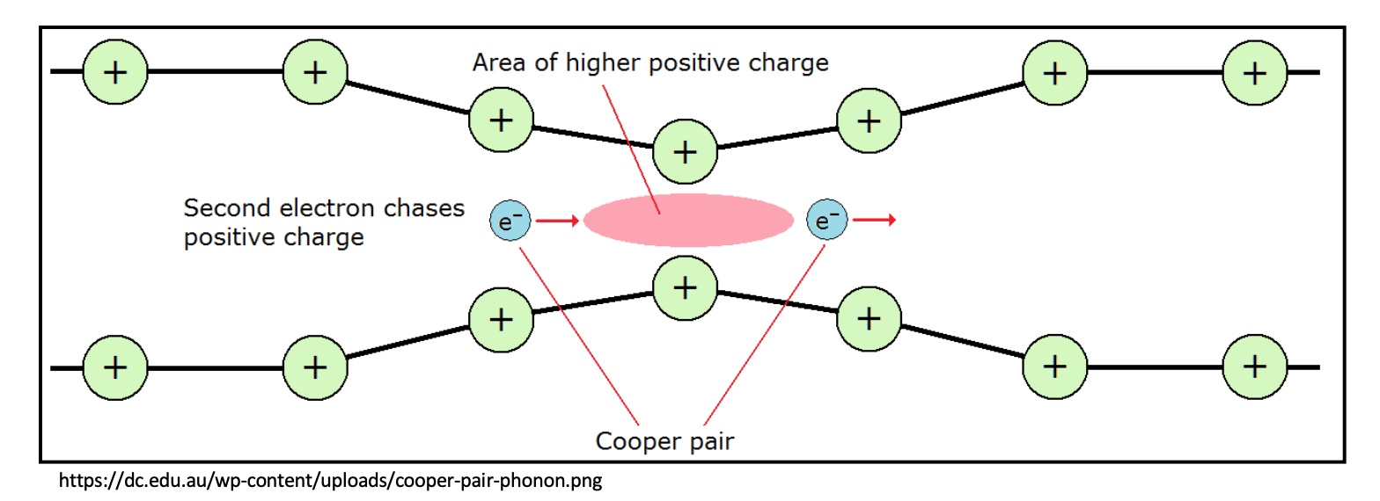
BCS Theory (Bardeen–Cooper–Schrieffer)
The pairing of electrons close to the Fermi level into Cooper pairs through interaction with the crystal lattice (Phonon)

Slide 39
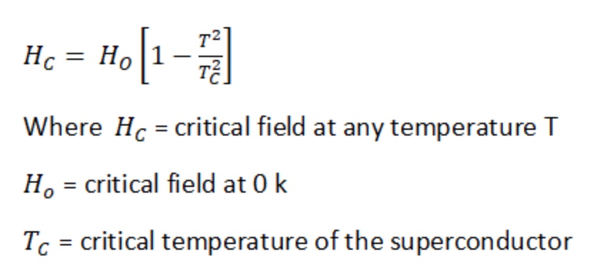
Effect of magnetic field
Below the transition temperature of a material, its superconductivity can be destroyed by the application of a strong magnetic field. The minimum magnetic field strength required to destroy the superconducting property at any temperature is known as critical magnetic field (H_{c}).
The critical magnetic field (H_{c}) depends upon the temperature of the superconducting material. The relation between critical magnetic field and temperature is given by

Slide 40
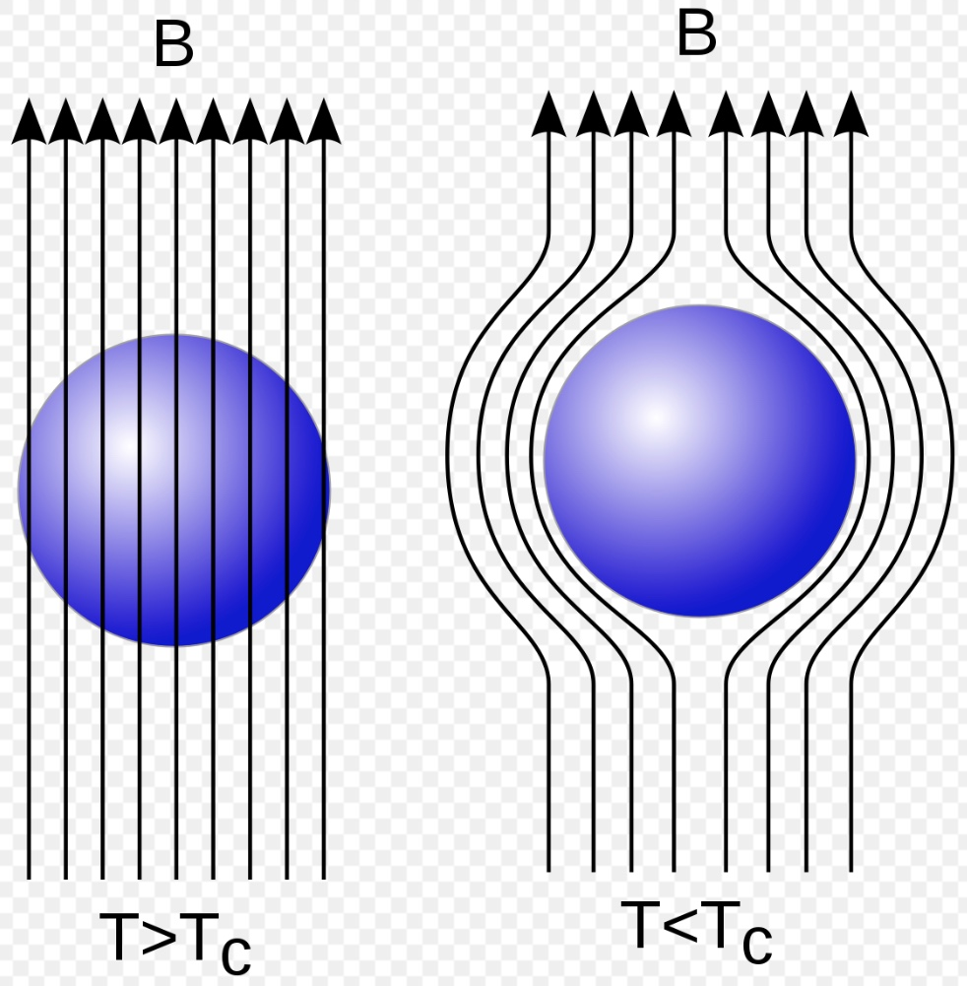
Meissner effect
When a superconducting material is placed in a magnetic field of flux density ‘B’ the magnetic lines of force penetrates through the material. When the material is cooled below its critical temperature (transition temperature) then the magnetic lines of force are ejected out from the material. Diamagnetic material have the tendency to expel the magnetic lines of force. Since the super conductor also expels the magnetic lines of forces it behaves as a perfect diamagnet. This behaviour is first observed by Meissner and hence called as Meissner effect.

Slide 41
Types of magnets
There are two types of super conductors based on their variation in magnetization, due to external magnetic field applied.
Type – 1 superconductor (soft super conductor)
Type – 2 superconductor (hard super conductor)

Slide 42
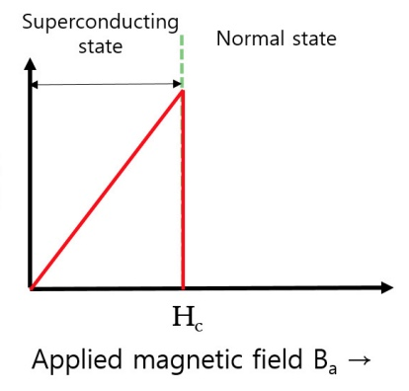
Type – 1 superconductor
When the super conductor is kept in the magnetic field and if the field is increased the superconductor becomes normal conductor abruptly at critical magnetic field. E.g. Lead (Pb), Aluminium (Al), Tin (Sn), mercury (Hg), Zinc (Zn) etc..
Below critical field, the specimen excludes all the magnetic lines of force and exhibit perfect Meissner effect. Type I superconductors are perfect diamagnet, represented by negative sign in magnetization.
Magnetization

Slide 43
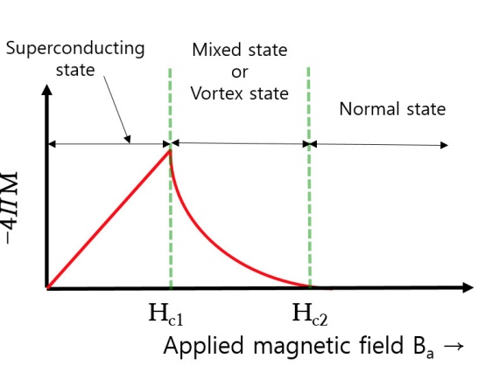
Type – 2 superconductor
The materials which lose its superconducting property gradually due to increase on the magnetic field are called Type II superconductor. E.g. niobium nitride (NbN), Niobium titanium (NbTi), Yttrium-Barium-Copper-Oxide etc..
When the super conductor kept in the magnetic field and if the field is increased, below the lower critical field H_{c1}, the material behaves as a superconductor (exhibit perfect diamagnetism) and above H_{c1}, the magnetization decreases and hence the magnetic flux starts penetrating through the material. The specimen is said to be in a mixed state between H_{c1} and H_{c2}. above H_{c2} (upper critical field) it becomes normal conductor.
Magnetization

Slide 44
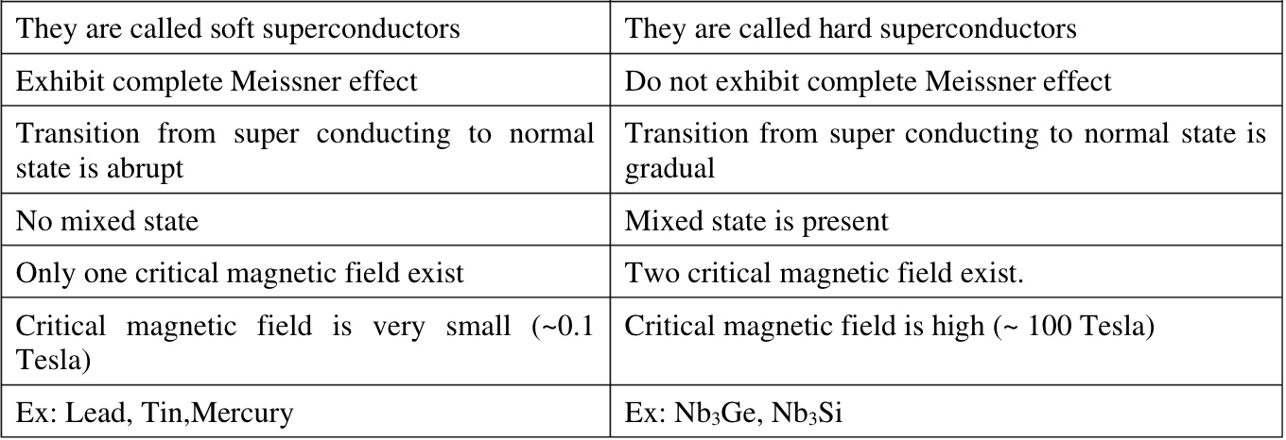
Difference between type – 1 and type - 2
Type - 1
Type - 2

Slide 45
Applications of superconductor
Medical: Used in NMR (Nuclear magnetic resonance), MRI (magnetic resonance imaging) etc..
Transportation: Magnetic levitation (Maglev trains) etc..
Electronics: SQUIDS (superconducting quantum interference device), Quantum computing, Sensors etc..
Research: Particle Accelerators, Magnets, Plasma / fusion research etc..

